Slide 1
The Age of Realism
Civil War through 1914

Slide 2
From Romanticism to Realism
Prior to the Civil War, we were confident in our country and ourselves
The Civil War shook our image of who we were
We lost our confidence and our idealism, and came down out of the clouds into a harsh reality
This disillusionment stuck with us until World War I, when we regained our confidence

Slide 3
Civil War
Civil War: when an entity splits itself into factions, and destroys itself in the process
Causes
Slavery was at the root
Economic: the South was more financially successful because of its work force
Social: classes and wealth divided the South’s social classes
Political: The South wanted state government in control; the North wanted the federal government in control
Ideal Outcome: All or Nothing
Reality: brutal, evil, futile, disillusionment

Slide 4
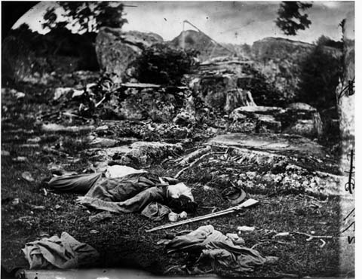
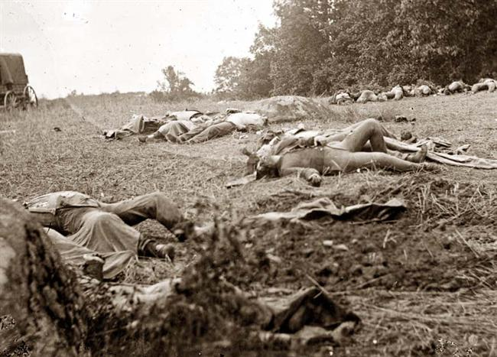
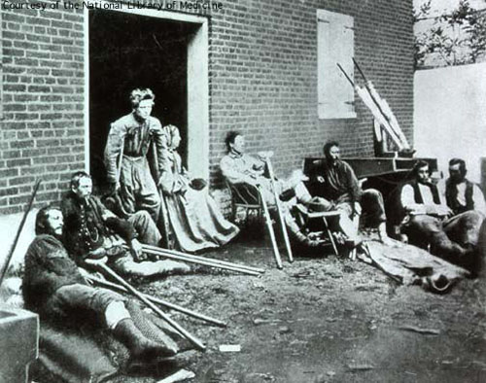
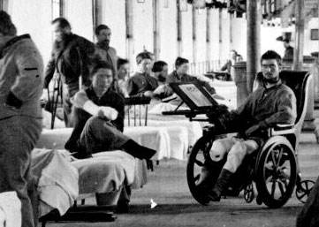
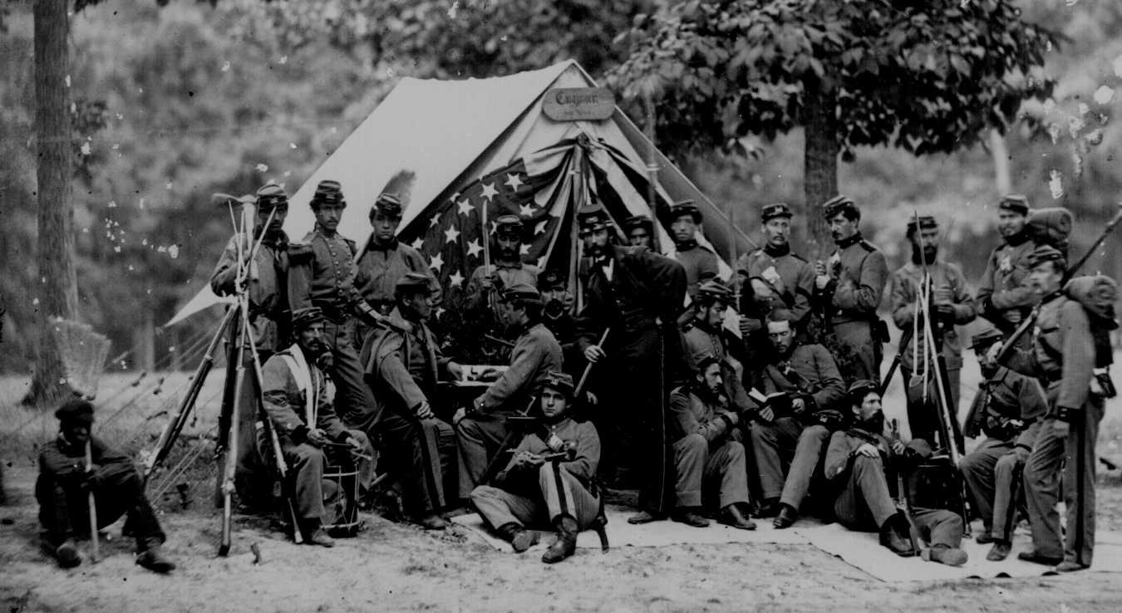
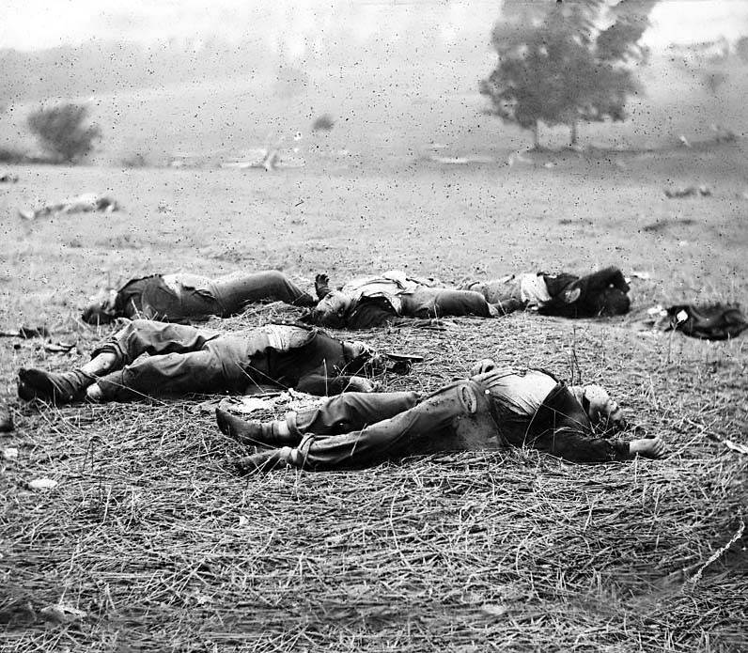
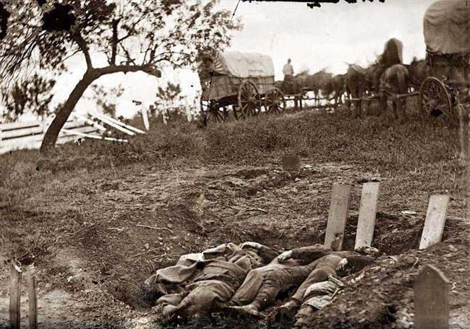

Slide 5
Realism
Some say this was America’s teen years, when we started to understand things but at the expense of our innocence
Mark Twain, Stephen Crane, Jack London, Frederick Douglass, Ambrose Bierce
All created real-life characters, rooted in non-fiction, but written as fiction

Slide 6
The Civil War in Literature
The age of the Romantics had led us into fiction, but that was inappropriate in this sad time
Non-fiction was too close to our hearts; people didn’t want to hear the details
Writers found a mix of fictional characters and realistic situations; called this style REALISM

Slide 7
Realism
Rejected larger than life characters and heroes
Showed humans as real, honest, making mistakes
Ordinary characters in realistic situations
Use of speech to explain social class
Focused on ethical struggles and social issues

Slide 8
Realism
Regionalism
Literature that emphasized a specific region (Southern, Northern, Eastern, Western)
Naturalism
Literature that focused on the Man vs Nature battle (usually with man losing)
Psychology
Explored motivation (Why do we do that?)
Looked at humans in crisis (What did we do?)

