Slide 1
Encounters and Foundations through 1800
Columbus did not discover a new world; he established contact between two worlds, both already old.
--J.H. Perry

Slide 2
Early Encounters
This land was largely inhabited by American Indians
Early relationships were based on curiosity and interdependency
Early settlers exposed the American Indians to smallpox and other illnesses, which killed entire Indian villages

Slide 3
The Puritans
Christian fundamentalists who wanted a purer Church of England
Because they opposed Henry VIII’s involvement in the church, they were persecuted
Fled to Holland, and then to the “new world”
They believed the world was made up of two groups: the saved (the elect) , or the damned (the unregenerate)
Five basic beliefs:
Humans are sinful by nature
Most people are damned for eternity
Salvation belongs to the “elect”, who can be identified by their virtue (purity)
Hard work and worldly success are signs of God’s grace
People should live in a thrifty, self-reliant and simple manner

Slide 4
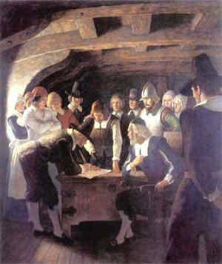
More on the Puritans
Believed in establishing contracts with government
Established the Mayflower Compact, the first real governmental document of America
The Bible was considered the ultimate work of literature, and was widely read—which means that Puritans valued the ability to read and educated themselves
The Salem Witch Trials were the reaction to threats against the Puritan way of life

Slide 5
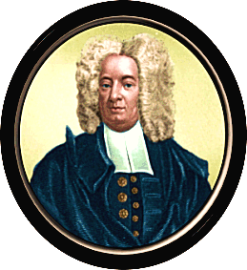
Beyond Puritanism into Reason
People began to move outside of religion for thought, and thus began the Age of Reason
As the smallpox epidemic spread in the new world, science emerged, because faith couldn’t fight smallpox
Cotton Mather promoted inoculating people with smallpox as a measure to prevent the disease
Rationalists began to emerge, combining a belief that religion had to be combined with common sense

Slide 6
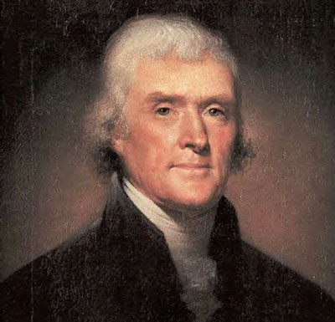
From Reason to America
Diesm emerged, in which followers believed that man is generally good, that God is on our side, and that the best service to God was service to others
These ideas became the foundation of American Democracy, promoted by Benjamin Franklin, Thomas Jefferson, George Washington, and other founding fathers.

Slide 7
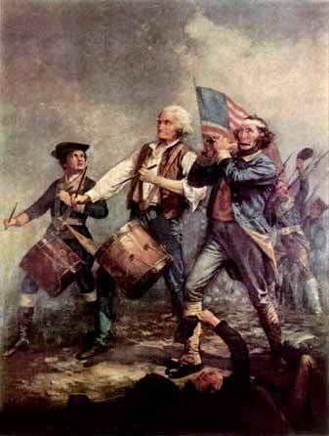
America is Born
American ideas became the American Dream, which demanded independence from England
The Revolutionary War was our official separation from England
Americans wrote the Declaration of Independence, followed by the Constitution of the United States

Slide 8
Concepts in Early American Literature
Author’s Purpose
Why did the author write this?
What was his/her intention?
Generalizations
What does this reading indicate about early Americans?
What kind of people were early Americans?
Application of information to situations
How is this information still applicable today?
Do we still use scare tactics to get people to change, as did Jonathan Edwards?
Do Benjamin Franklin’s aphorisms still apply?

