Slide 1
American Romanticism 1800-1860
We will walk on our own feet; we will work with our own hands; we will speak our own minds.
Ralph Waldo Emerson

Slide 2
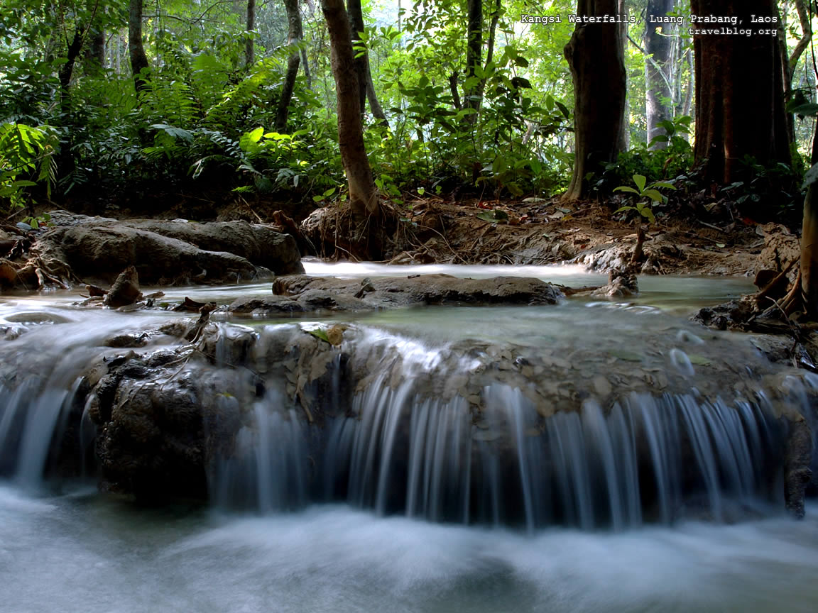
Romanticism in america
We were still a very young country, just starting to form our own literary style
Romantic writers valued feeling and intuition over reason
Emphasis on imagination, individual feelings, and wild nature

Slide 3
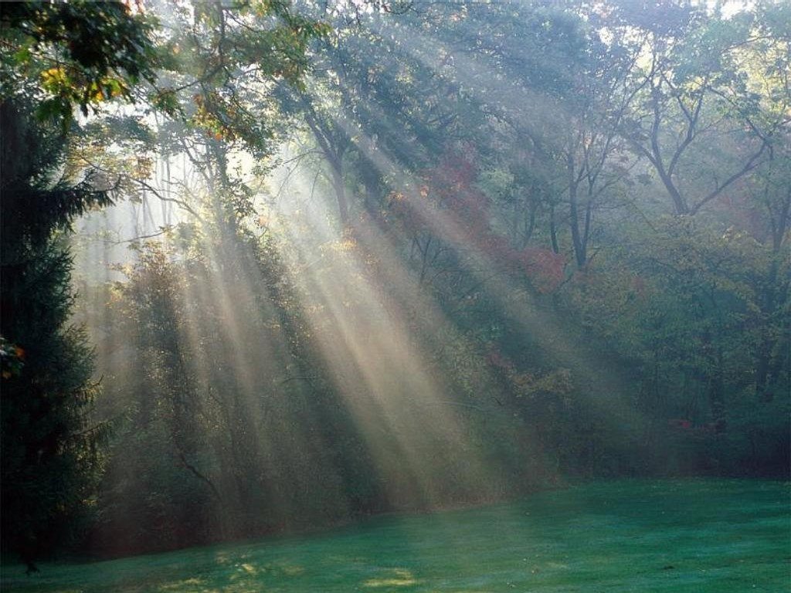
The Romantic Ideal
To rise above “dull realities” to a realm of higher truth
by developing and describing exotic, beautiful settings
By revealing the underlying beauty and truth of nature

Slide 4
Romanticism characteristics
Value feeling and intuition over reason
Place faith in inner experience and imagination
Shun artificiality of civilization and return to nature
Prefer youthful innocence to educated sophistication
Champion individual freedom
Reflect on nature to find spiritual and moral guidance
Trust in the wisdom of the past and distrust progress
Find beauty in exotic locales, the supernatural realm, and the inner world of the imagination
Use poetry to express the imaginings
Find inspiration in myths, legends, and folklore

Slide 5
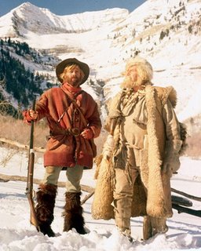
The American Novel and hero
Focused on and idealized frontier life
Hero was youthful, innocent, with a sense of true honor, not false modesty
Hero’s knowledge comes from experience and intuition, not formal education
Characters were seeking higher understanding of the world

Slide 6
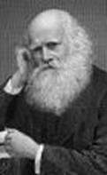
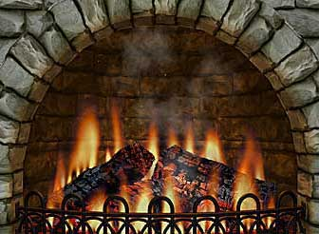
The Fireside Poets
Believed poetry to be the ultimate expression of imagination
Expressed American ideals while imitating European style
Were read at firesides for entertainment
Were old-fashioned and classical

Slide 7
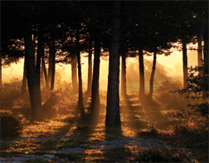
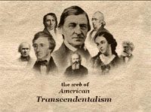
The Transcendentalists
Believed that to understand the world we must go beyond (transcend) the physical realm
Called themselves Transcendentalists
Believed that nature would reveal all of the world’s truths
Self-reliance, individualism, and deliberate learning were the strongholds

Slide 8
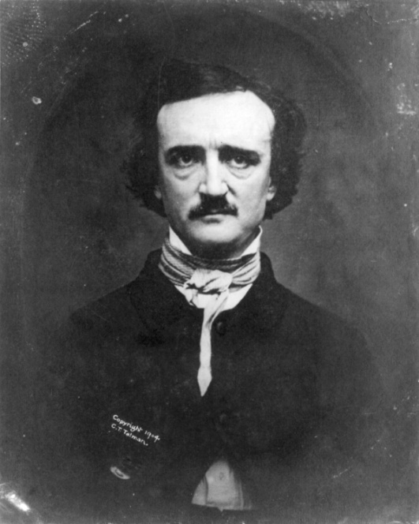
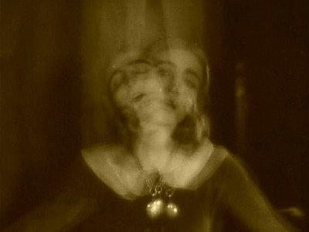
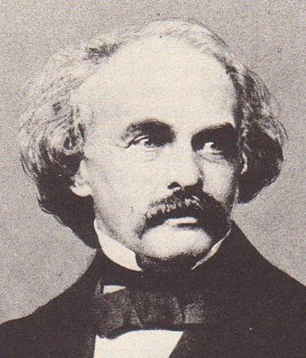
The Dark Romantics
Nathaniel Hawthorne, Herman Melville, and Edgar Allan Poe
Acknowledged the wickedness of humans, as well as the beauty of nature
Focused on conflicts between good and evil, guilt and sin, and madness

